Slide 1
Homework
Week 8

Slide 2
Questions 1-11
1. D
2. 0.09
3.
4. -2.5
5. D
6. C
7. 6.25 x 1000 = 6 250L
8. 4 – 1.5² = 4 – 2.25 = 1.75
9. A
10. C
11. C

Slide 3
Question 12
There are 200 animals on a farm. One-fifth of the animals are sheep and the rest are cattle. 40% of the cattle are calves. How many calves are on the farm?
Sheep = 200 x ⅕
= 40
Cattle = 200 – 40 OR Cattle = 200 x ⅘
= 160 = 160
Calves = 160 x 40%
= 64
ANSWER = 64 calves

Slide 4
Question 13
Which number is prime?
111 113 117 119
Answer = B

Slide 5
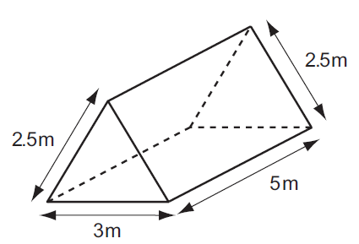

Question 14
This solid triangular prism needs all its faces painted. The area of each triangular face is 3m². What is the total area to be painted?
Total Area = (2 x 3) + (2 x 2.5 x 5) + (3 x 5)
= 46 m²
Answer = 46 m²

Slide 6
Question 15
Amanda sells T-shirts at a market for $15 each. Her costs are $6 per T-shirt and $540 per month rent. How many T-shirts must Amanda sell per month to equal her monthly costs?
6t + 540 = 15t (- 6t)
540 = 9t (÷ 9)
60 = t
Answer = 60

Slide 7
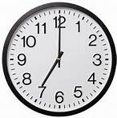
Question 16
The clock shows that it is seven o’clock. What is the size of the obtuse angle formed by the hands?
Angle = 360° ÷ 12 x 5
= 150°
ANSWER = 150°

Slide 8
Question 17
The mean (average) of eight numbers is 56. When one of the numbers was left out, the mean decreased to 54. What number was left out?
54 56 60 70
Total of numbers = 56 x 8
= 448
Mean without 54 = (448 – 54) ÷ 7
= 56.29
Mean without 56 = (448 – 56) ÷ 7
= 56
Mean without 60 = (448 – 60) ÷ 7
= 55.43
Mean without 70 = (448 – 70) ÷ 7
= 54
Answer = D

